Slide 1

Department of Computer Science and Engineering
A Mini Project on
“PUBLIC ENGAGEMENT PLATFORM”
Submitted by
SPOORTHI M S 1BH18CS095
VIJAYA PANDEY 1BH18CS103
Under the Guidance of
Ms. Leesa Banu

Slide 2
Contents:
Introduction
Literature Survey
Problem Statement
Proposed System
Advantages of Proposed System
Conclusion and Future Work
Implementation Snapshots
References

Slide 3
Introduction:
Ours is the largest democracy.
Representatives are selected in regular intervals.
But all the problems are not reached to the representatives.
There is a communication gap.
Even if the problems are reached , sometimes ignored.
We have a solution for these problems.

Slide 4
Literature Survey:
Sl.no | Title-Author name- Date of publish | Methodology | Disadvantages
1 | Incredible India Application by Mr. K.J. Alphonso 27-September -2019 | App is an effort by the tourism ministry to update domestic and international travellers about registered service providers, recommended places, and warnings of fraud and approved travel agents. The users can use location-based services for information on the place they are visiting and also plan their itineraries on the app. | when it comes to usage, the app is not very nifty and often lags. The user interface is also pretty monotonous and could do with a facelift.
2 | MEA (Ministry of External Affairs) application 9-December-2014 | Gives information about ministry’s services and activities. This is a pretty user-friendly application. | The app is not very nifty and often lags. Not concerned about minute issues about minute constituencies.

Slide 5
Problem Statement:
Not all our problems are reaching the government. Even if they do, the results are null or not satisfactory.
And most of the times they are ignored. And the process to file a complaint is quite old and is time consuming. Citizens have disengaged and stopped holding elected officials accountable to representing their interests.
Most people in this country feel like their voice and their vote don’t count, so why should they bother? The local representatives don’t come to know what the real problem is.
The main objective of our application is to connect the Citizens to the Parliamentarians.

Slide 6
Proposed System:
PEP’s main features are:
Advantages:
News Feed
Assembly
Complaints
Query and Answers
Polling
RTI
Our endeavor to promote the active participation of Indian citizens in their country's governance and development.
Concerned about the minute issues about the constituencies where existing system somewhere fails.
Involvement of local representatives.
There is also an option to tell the problems & the same will be acknowledged to the local public representatives.
Other users can up vote it if they feel they are facing the same issue.

Slide 7







System Architecture:
Access
BROWSER
END USERS
Register
Get News
Updates
Get News
Updates
Add News
Updates
Assembly
Get news updates
Public
Register
Complaints
Q and A
web
View &
Up vote
Add and Manage Query
Answer
View Complaint
Section
Representative
View Feedbacks
RTI
Public
Representative
Admin
Admin
Backup server
Server

Slide 8
Admin module
ADMIN
Login
Valid
cred
Add and Manage Query
News Updates
Manage News
Feedbacks
Add News
Successfully added
Viewed
Successful
Successfully added
Viewed

Slide 9
Public module
PUBLIC
Start
No
Registered?
Yes
Signup
Login
Valid
cred
Valid
cred
News Updates
Assembly & RTI
Complaints
Polling
Answer
Viewed
Got info
Registered complaint
Viewed comp&upvoted
Viewed query and answered

Slide 10
Representative Module
start
REPRESENTATIVE
Login
Valid
cred
Complaints
Query and Answers
News Updates
Viewed
Viewed
Viewed

Slide 11
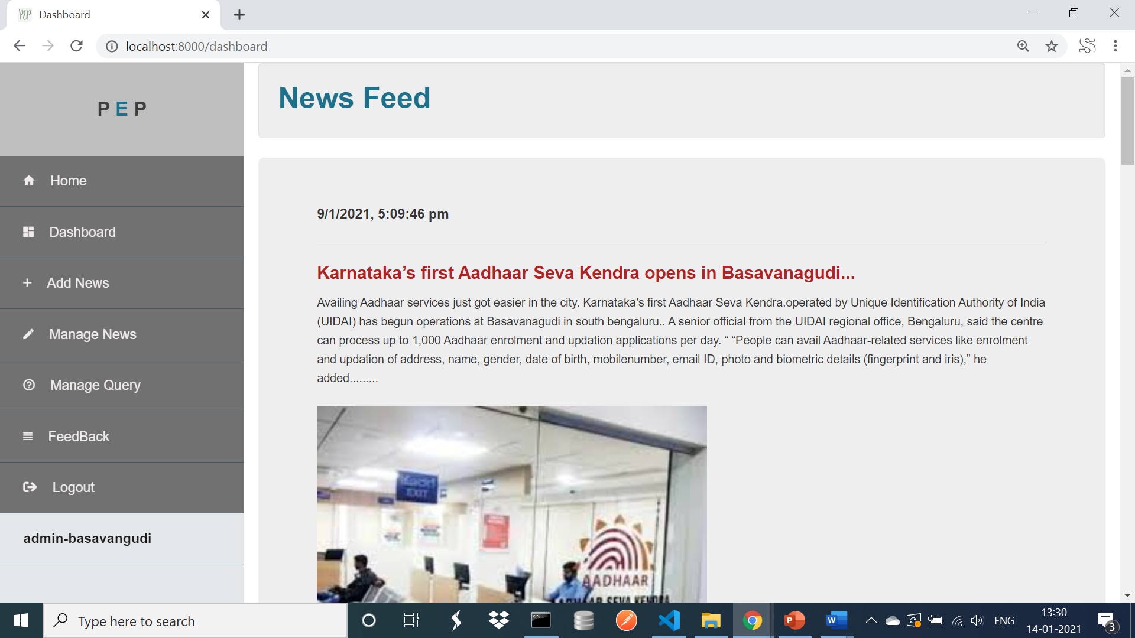
IMPLEMENTATION ADMIN:
This is the main module of the system. Admin has the authority to add news.
He also has authority to add Query Section to the public.
Public can get the news updates added by the admin.
Admin can also view the Feedbacks given by the public

Slide 12
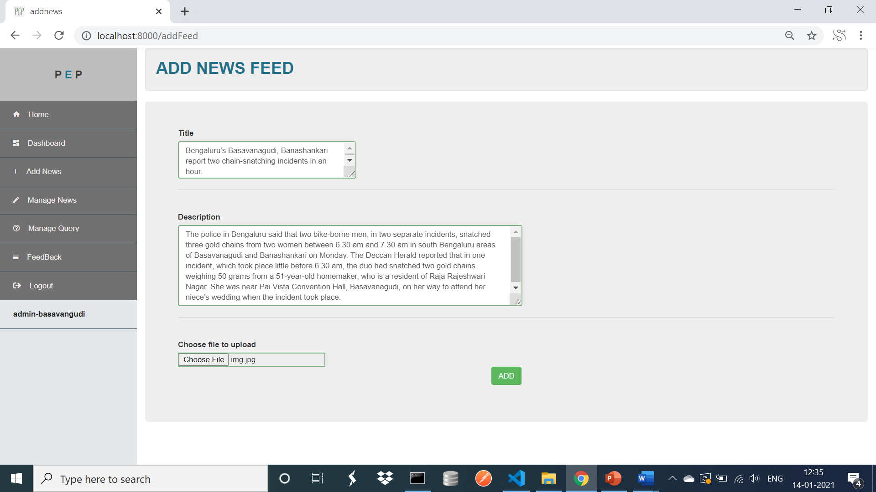
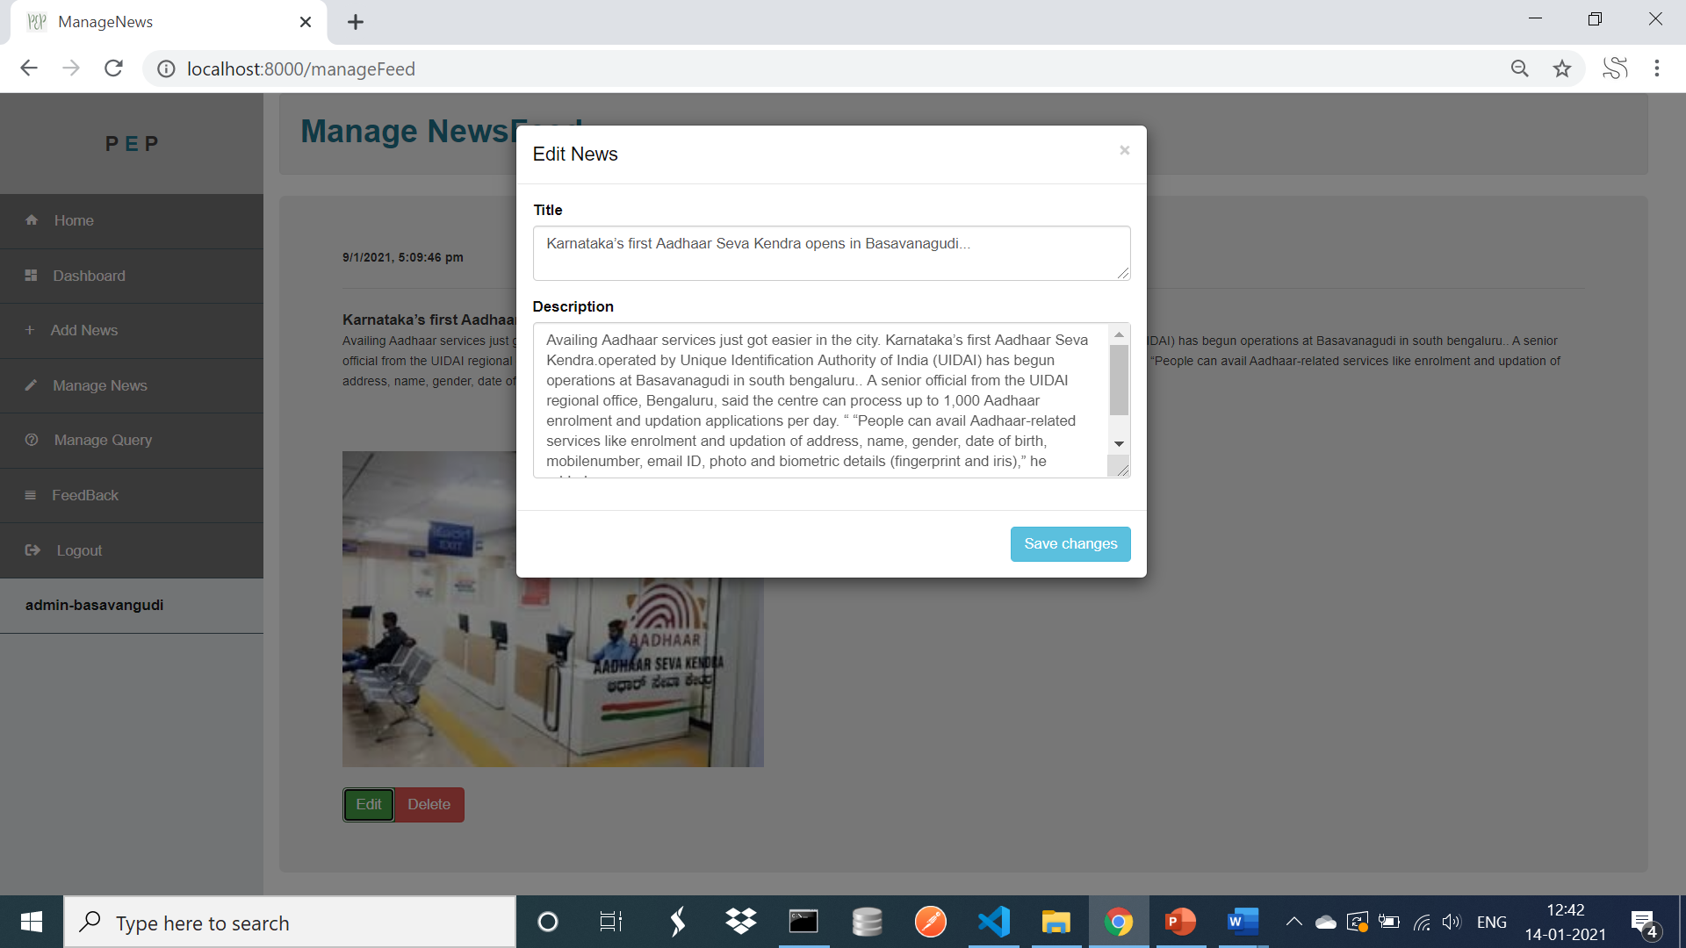
1.Adding and Managing news by admin

Slide 13
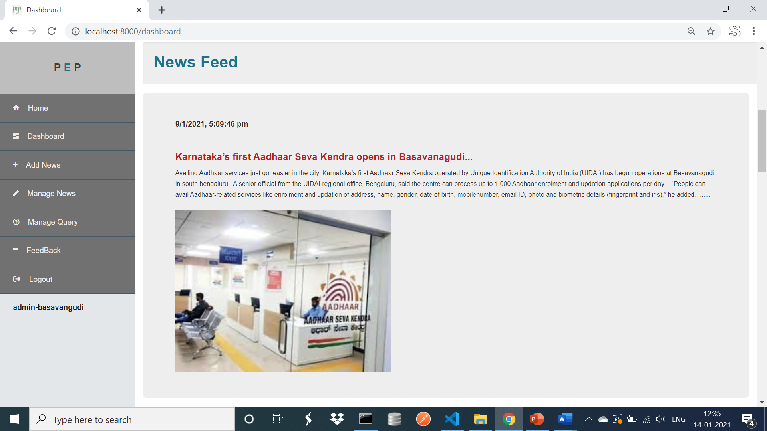
2.News Updates

Slide 14
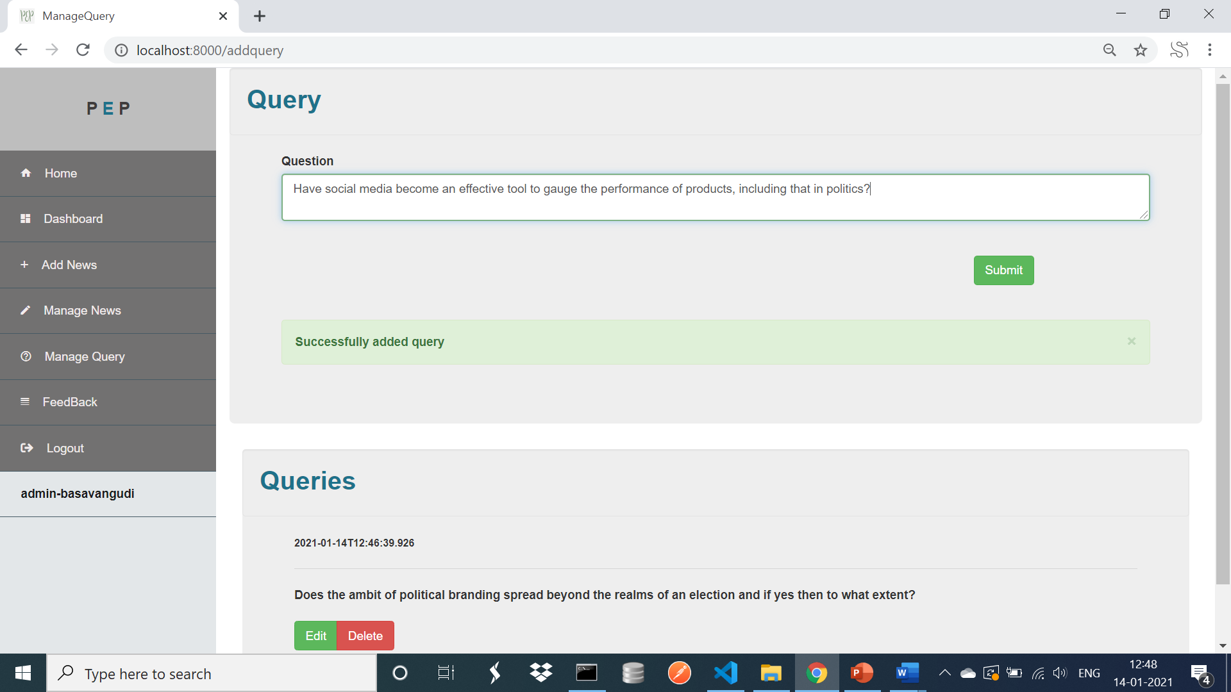
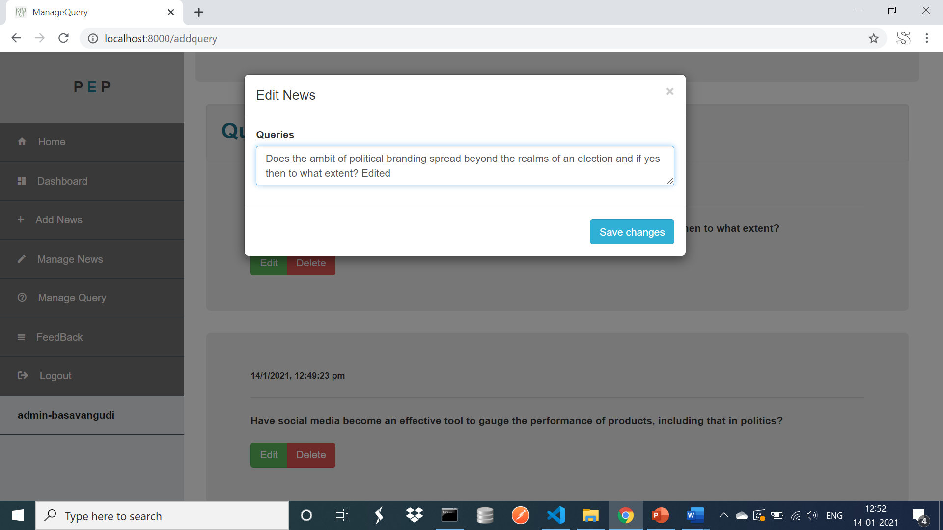
3.Add and Manage Query

Slide 15
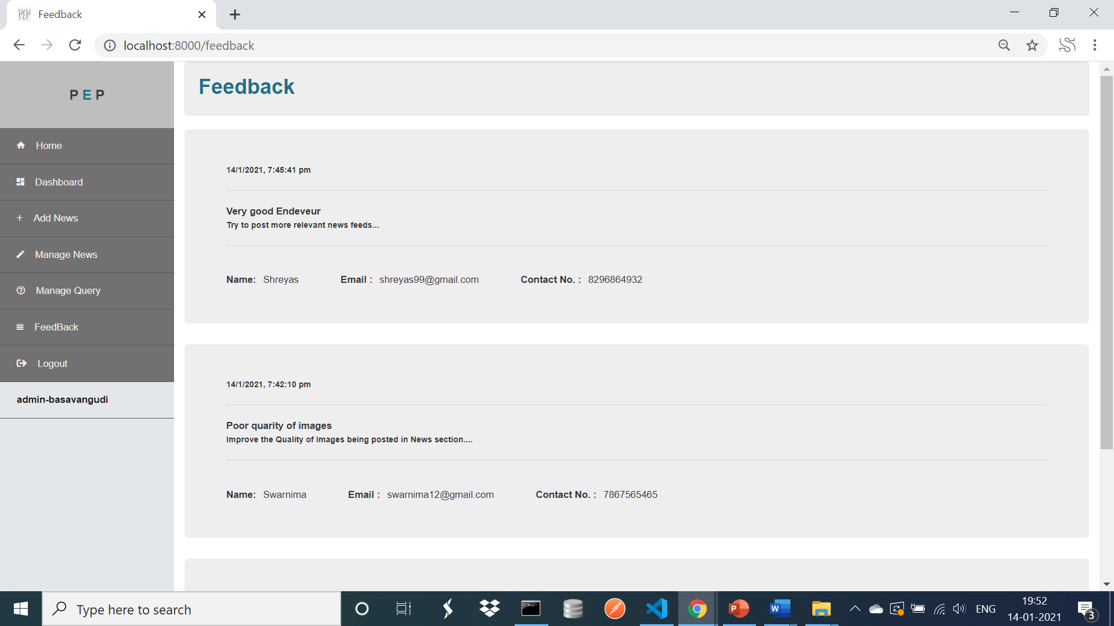
4.View Feedbacks

Slide 16
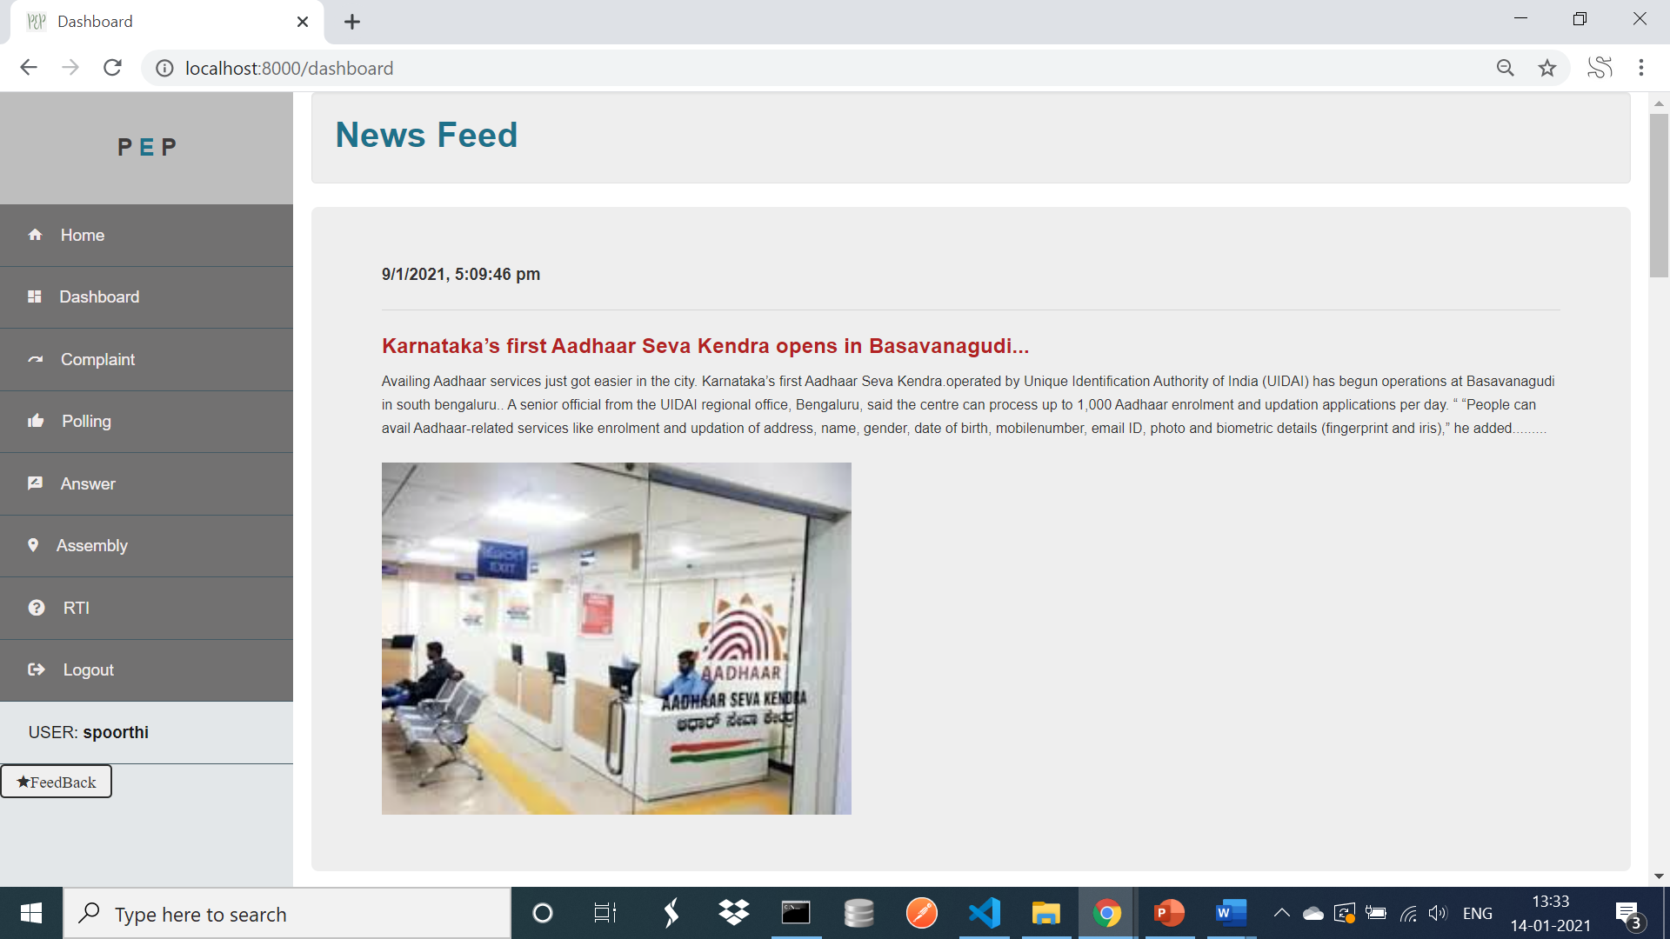
PUBLIC:
The public to avail the services of the PEP he has to first register by giving the valid credentials.
After which he can login and get the news updates in the home page of his account.
The public can register a complaint, up vote any issue in the polling section if he is going through the same problem. He can answer to the Query posted by the Admin of the Constituency. He can get all the information of his constituency in the Assembly Section.

Slide 17
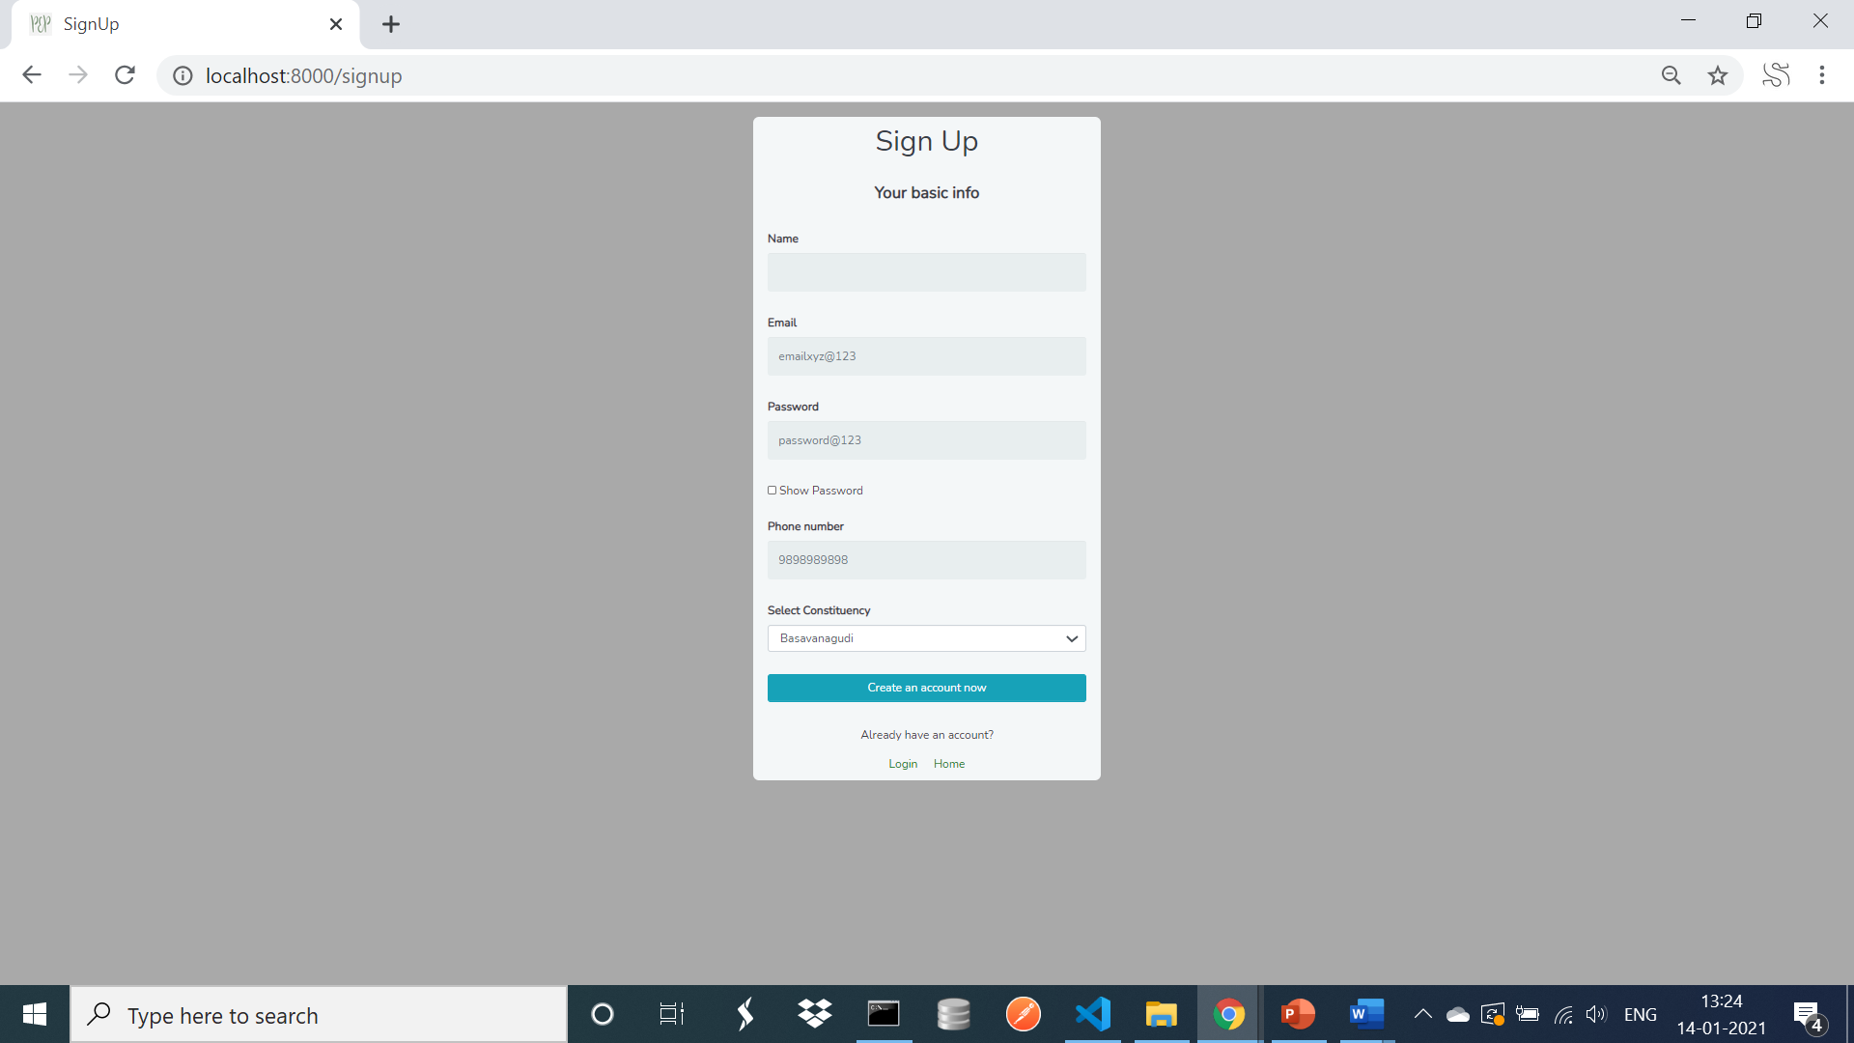
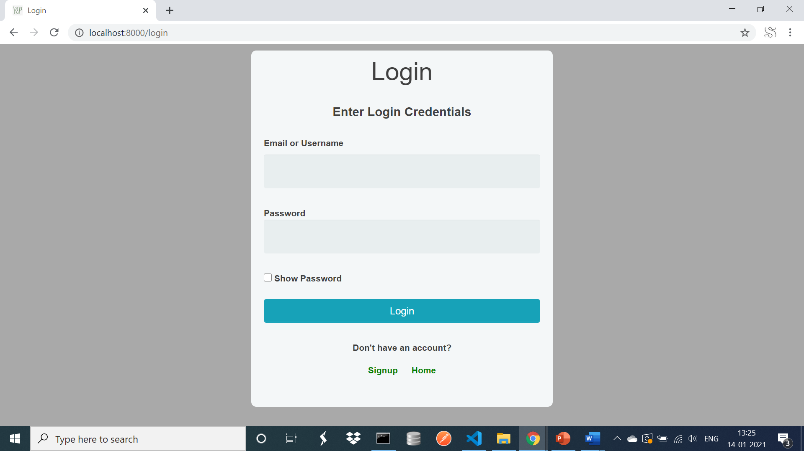
1.Signup and Login

Slide 18

2.News Feed

Slide 19
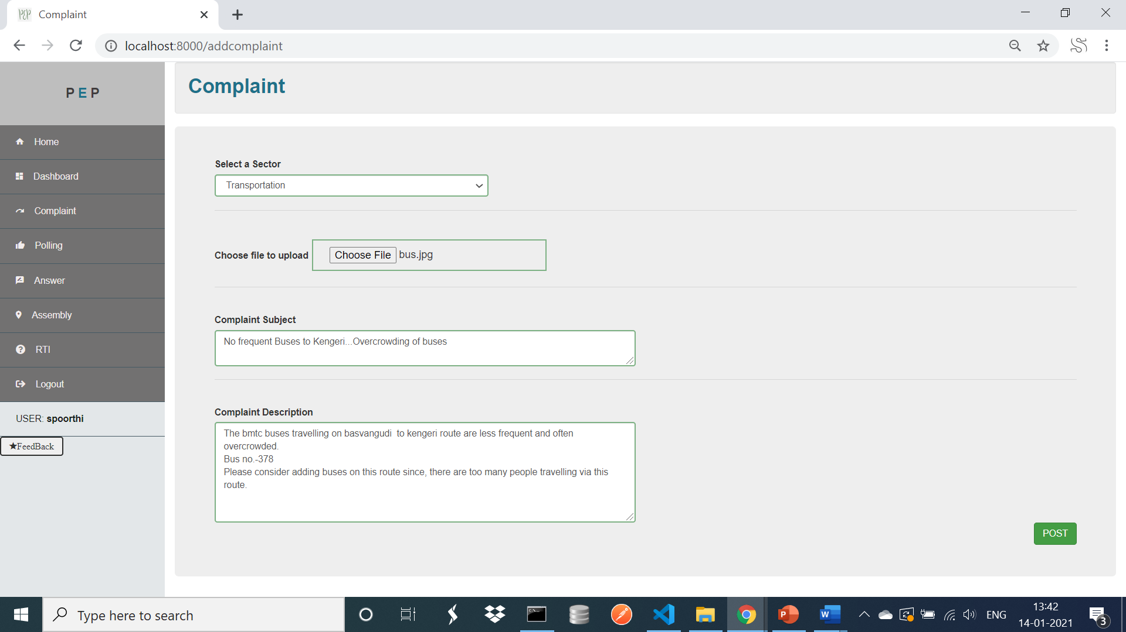
3.Complaint Section

Slide 20
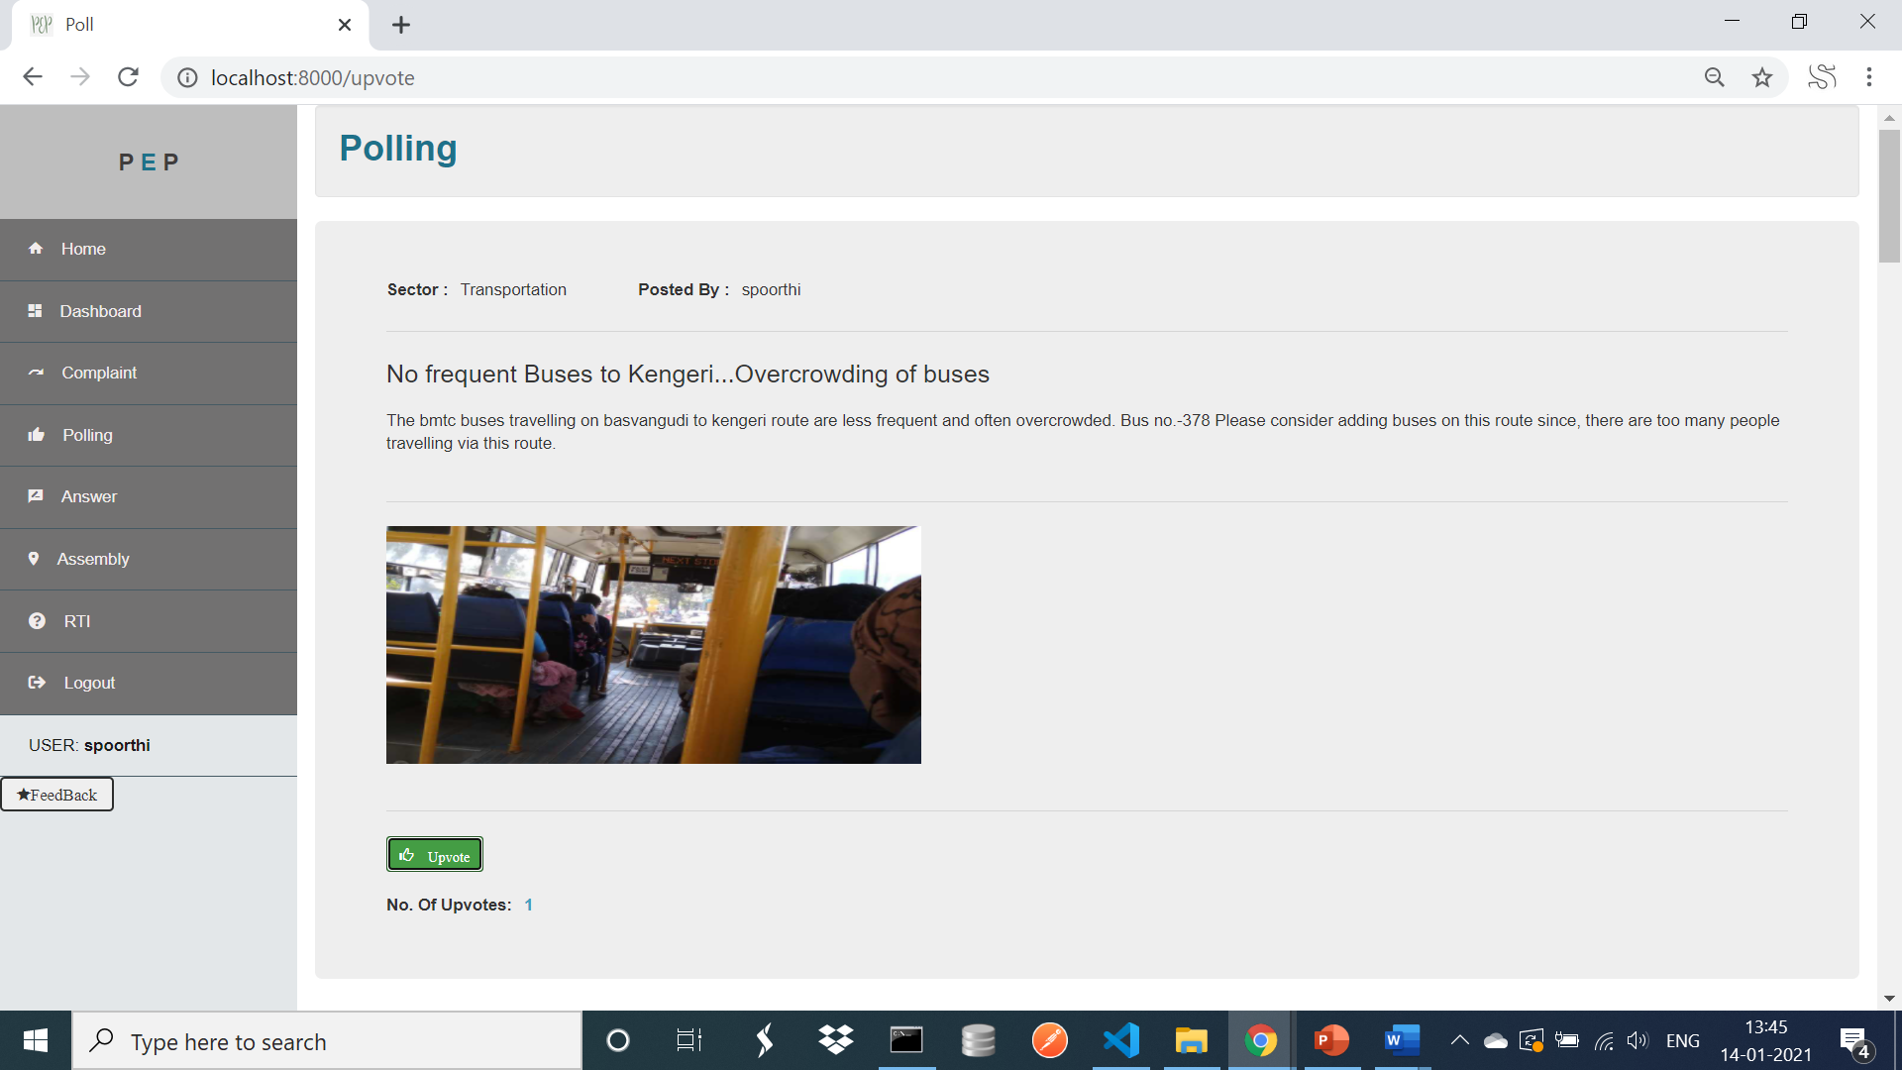
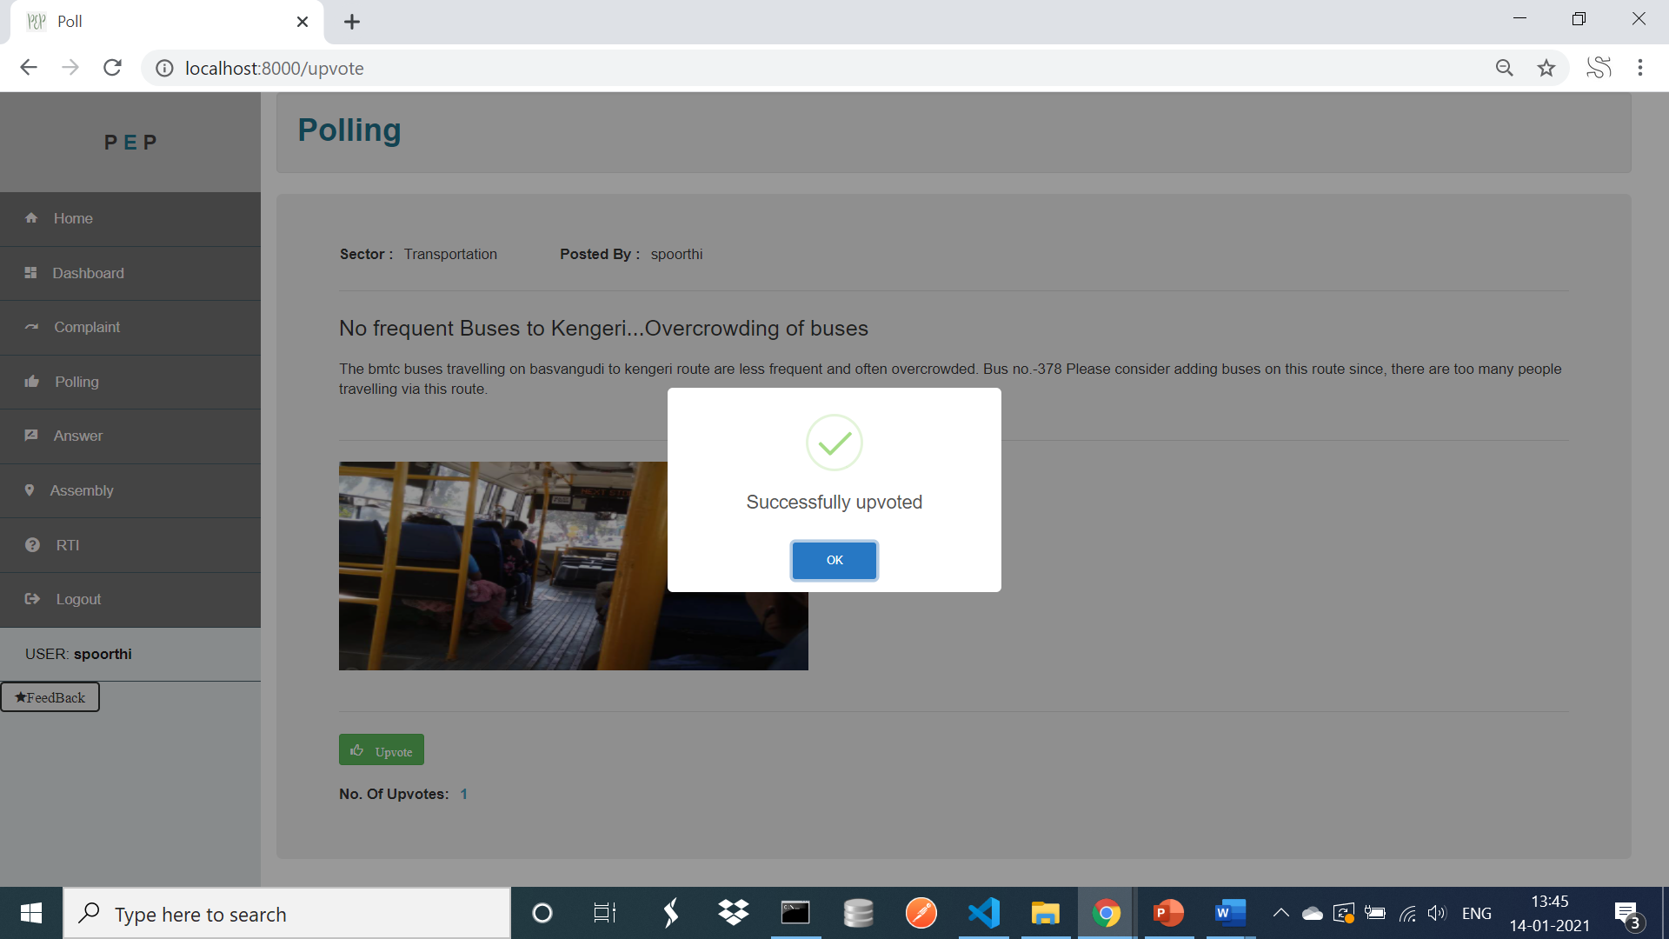
4.Polling

Slide 21
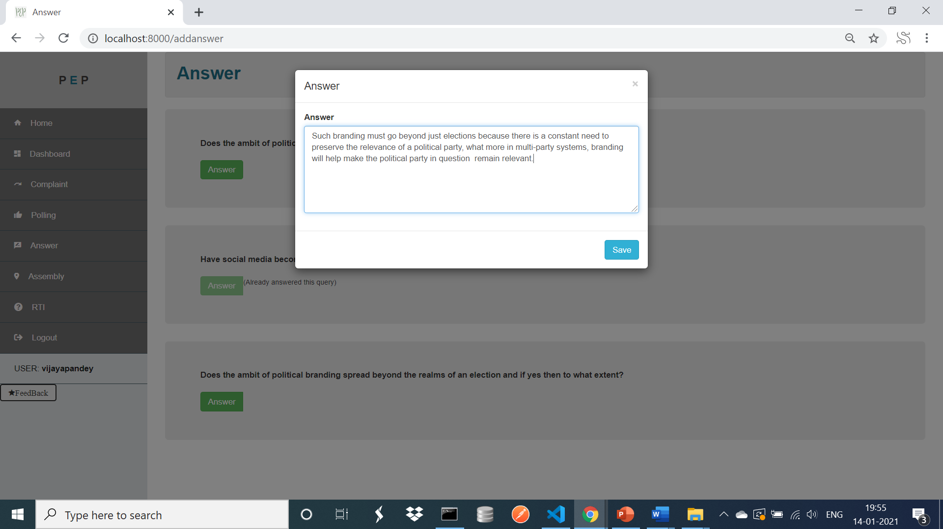
5.Answer

Slide 22
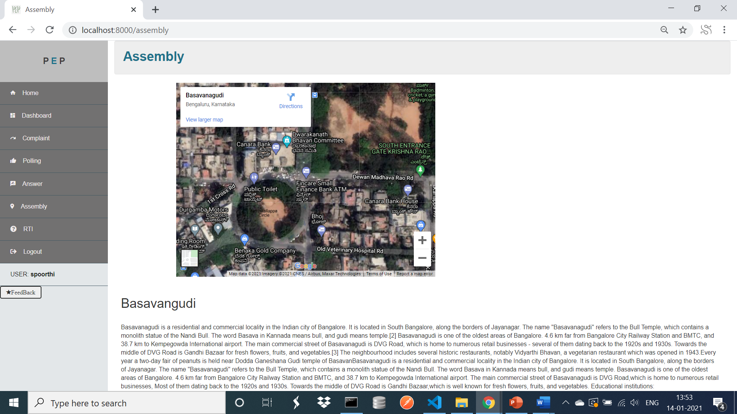
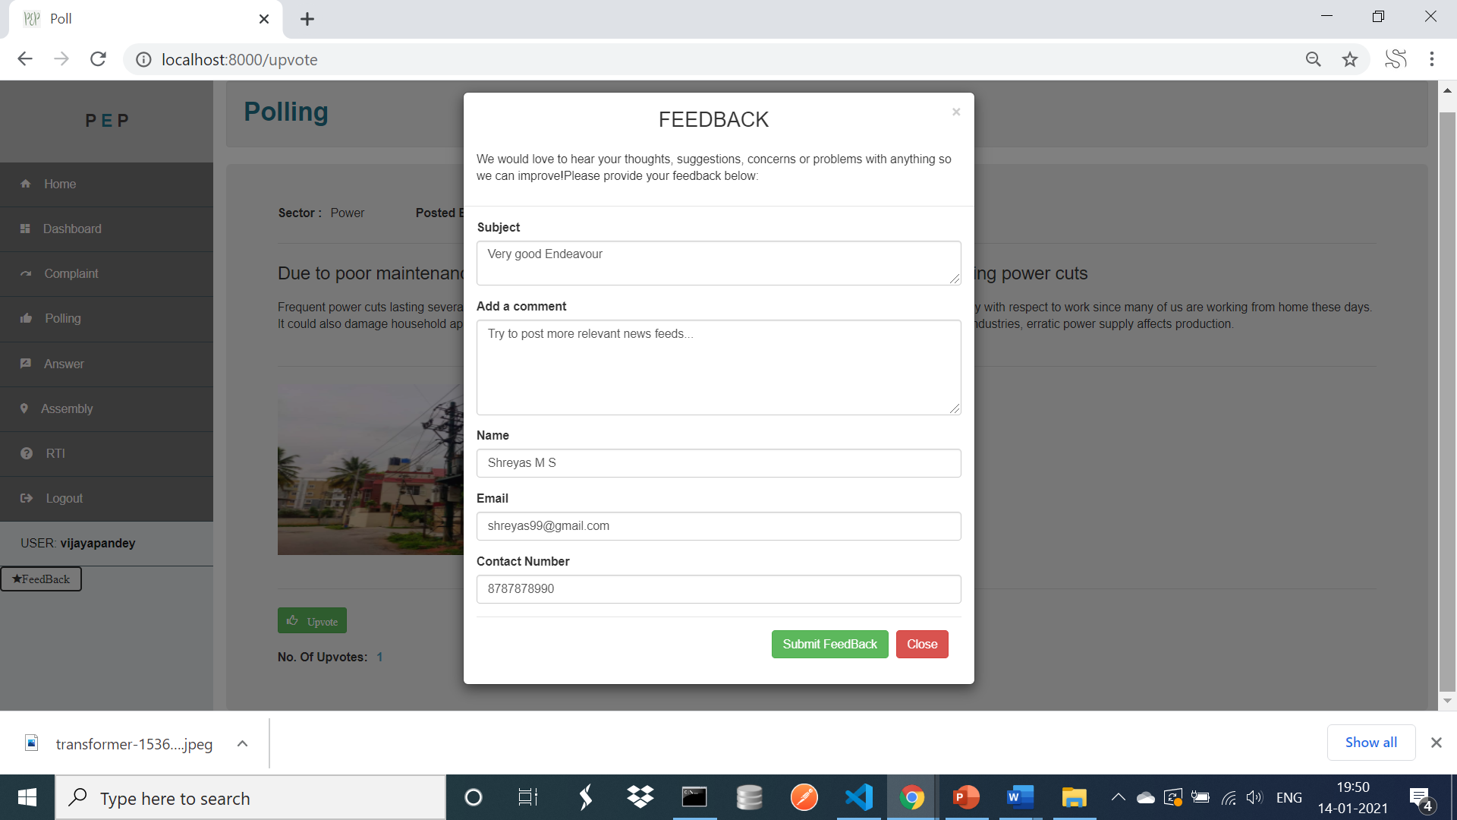
6.Assembly and Feedback

Slide 23
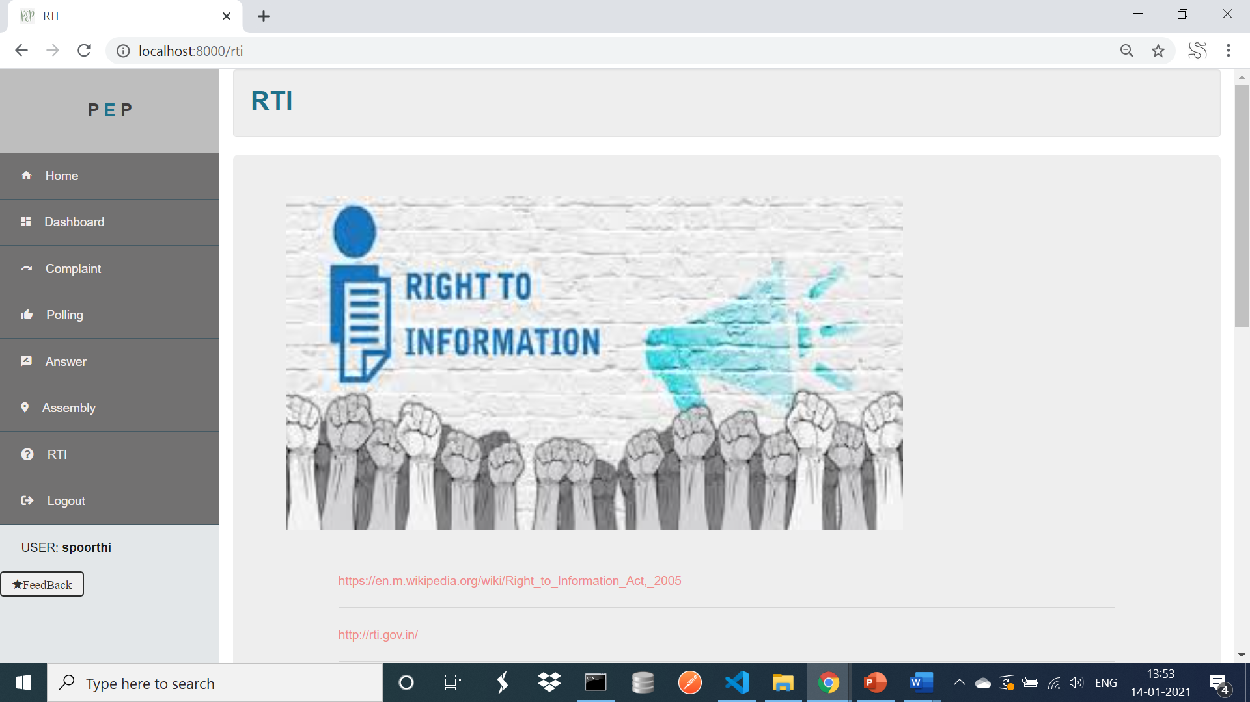
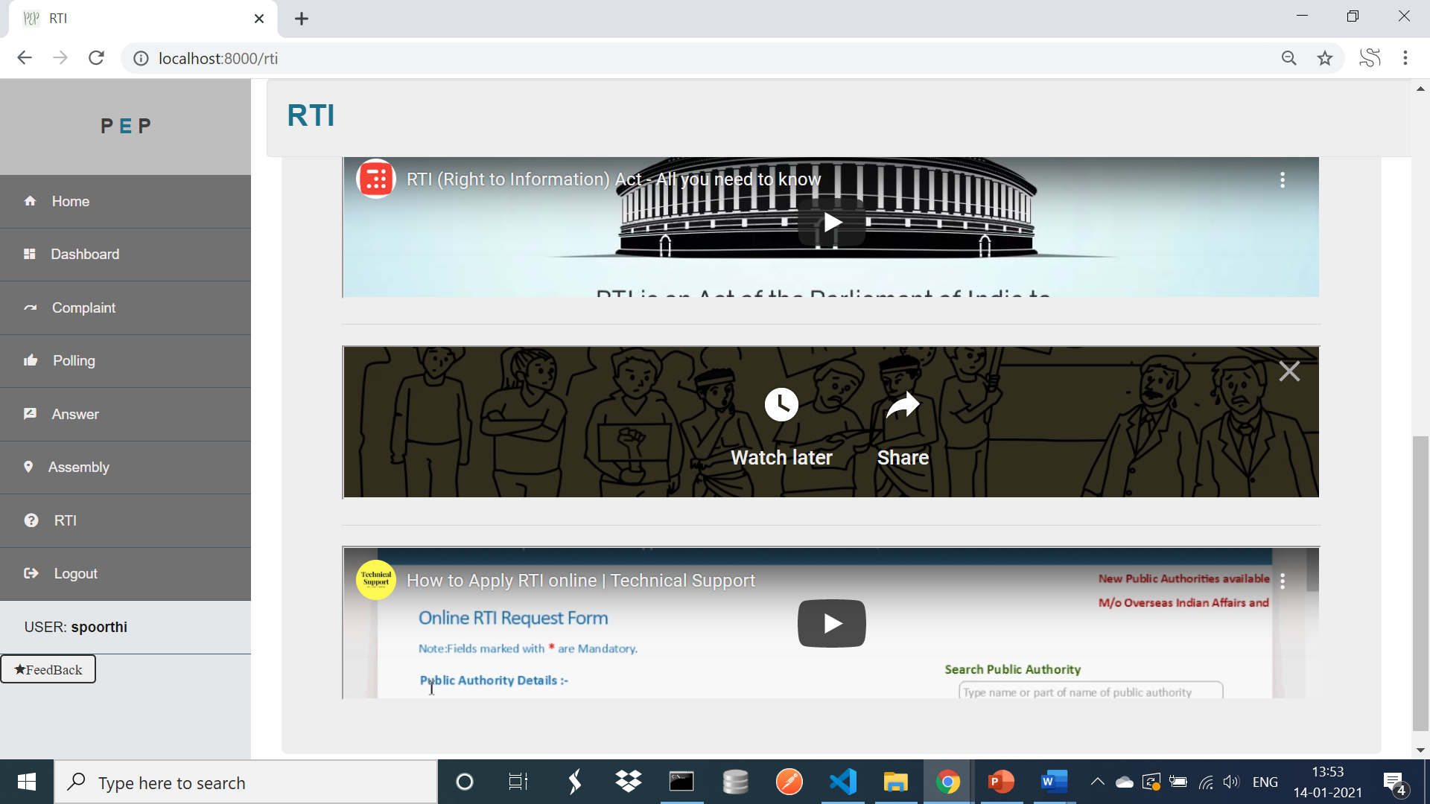
7.RTI

Slide 24
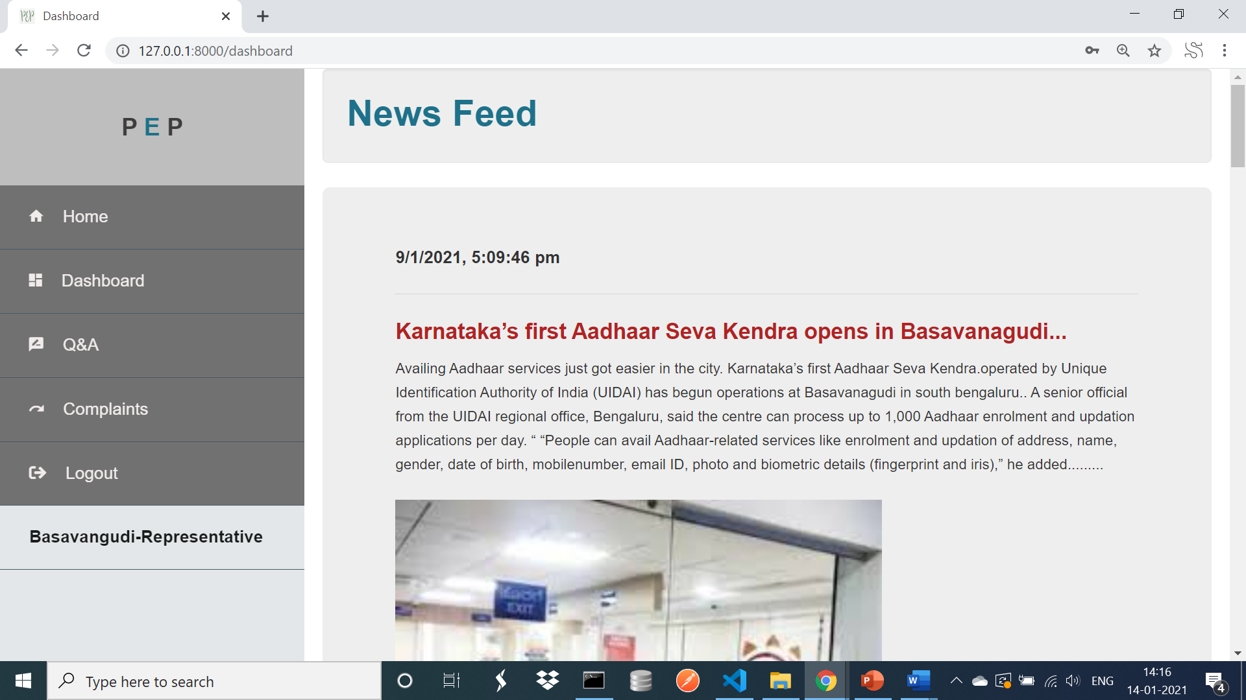
REPRESENTATIVE:
The Representative gets all the news updates about his constituency.
He can view the complaints registered under his constituency by the public and thus understand the seriousness of the issue.
He can know the views of public with the development happening in his constituency in Q&A Section.

Slide 25
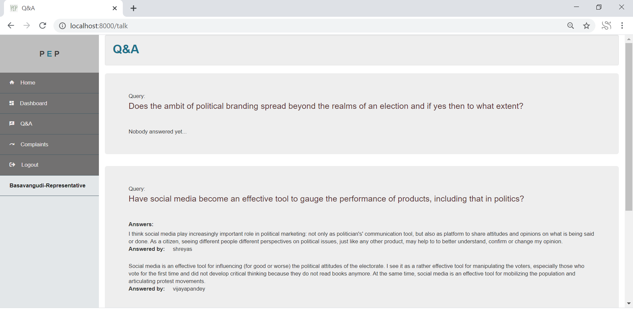
1.Q and A

Slide 26
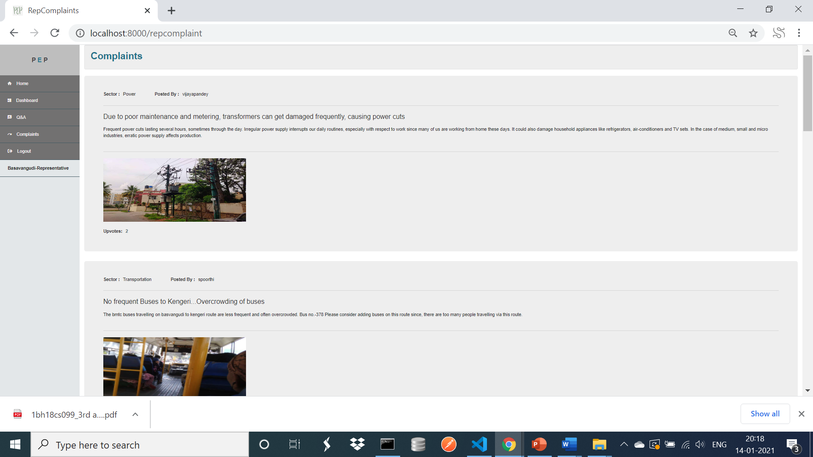
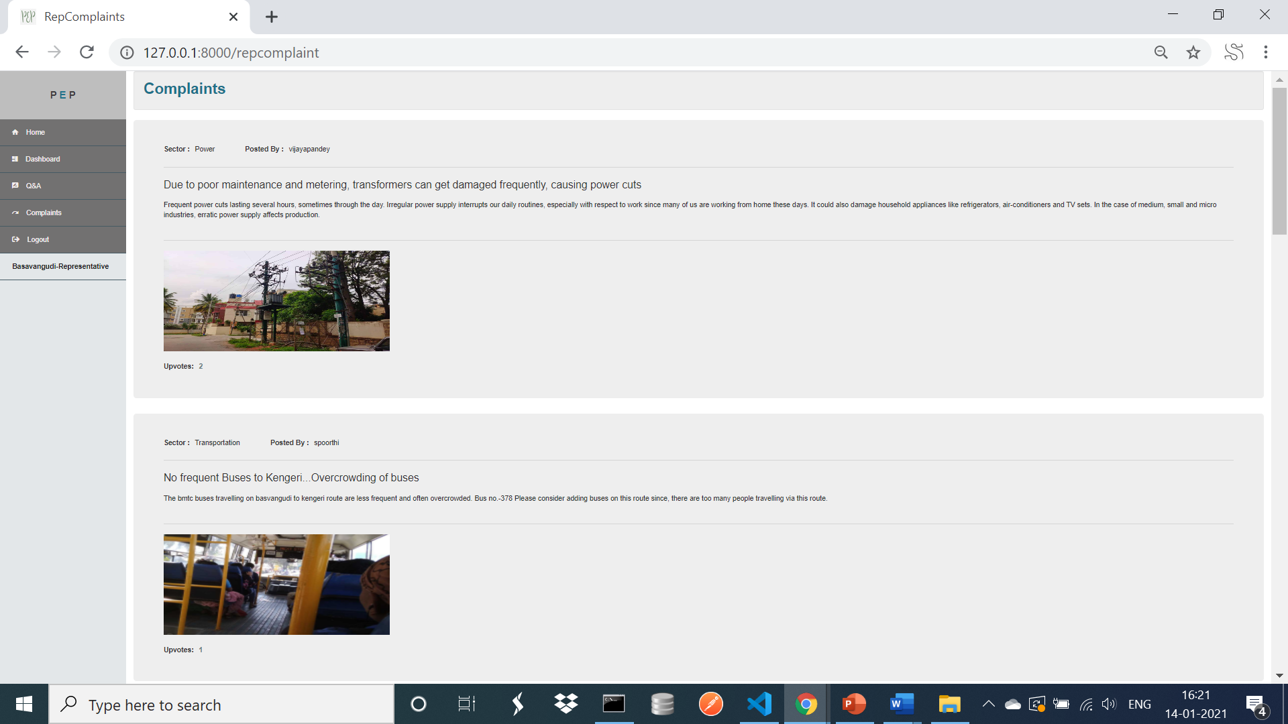
2.Complaints

Slide 27
CONCLUSION
It is also aimed at creating a common platform for citizens to crowd source governance ideas from citizens also. Creates awareness about rising public issues by registering complaints Helps politicians to maintain accountability. Gives information about RTI.
FUTURE WORK
Aadhar authentication API can be used for verifying the common man who has to register.
Login can be facilitated through social networking sites such as Facebook.

Slide 28


